Slide 1
Flow Charts
The Visual Language Anyone Can Read.
Chapter: 7

Slide 2
Flowcharts
Also called process flow diagram.
Step by step visual representation of a process.
First usage in 1921 by two industrial engineers to term flow process chart.
Chart divided into horizontal and vertical to describe flow.
Many online and offline tools for drawing available.
Symbols can be drag and dropped using tools.
Tools are raptor, LARP, and many more.

Slide 3
Introduction To Flowcharts
Flowcharting, process of developing flowchart.
Also called process flowcharts, process flow diagram and so.
Associated with UML and DFD diagrams.
Two main boxes; rectangle and diamond.
Rectangle box represent processing.
Diamond shape denote decision.
Four types of flowchart:
Program flowcharts.
Data flowcharts.
System flowcharts.
Data flowcharts.

Slide 4
Steps In Designing A Flowchart
Define the algorithm.
Assign a title for flowchart.
Decide inputs and outputs.
Identify limitations.
Brainstorm the activities that will take place.
Logically arrange the sequence.
Draw the shapes and connect it.
Review and modify the flowchart.

Slide 5
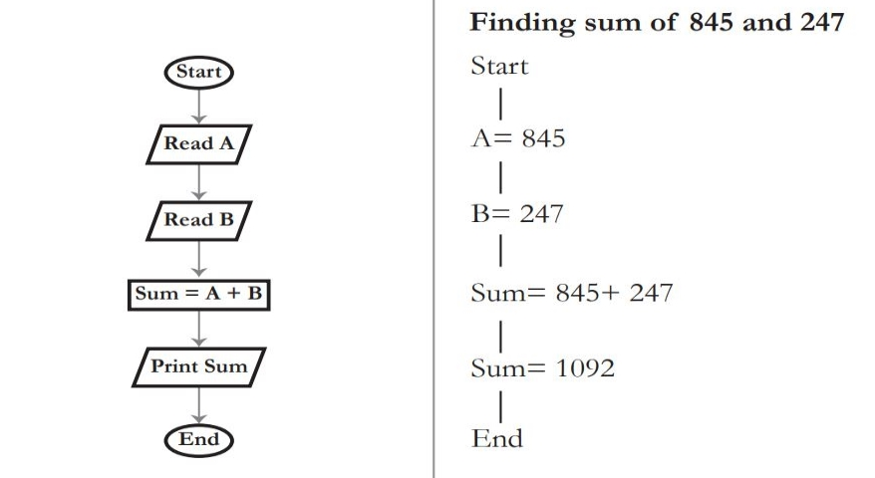
Sample Flowchart For Sum Of A & B

Slide 6
Name | Symbol | Function
Start or End |  | Denotes the starting or ending of an algorithm.
Action or Process |  | Box represents a single process within a large process.
Document |  | Denotes a printed report or document.
Decision |  | A decision point denotes different decisions emerging from different points.
Input or Output |  | Represents the input given by the user or the result generated by the system.
Connector |  | Indication that the flow continues where a matching symbol has been placed anywhere else in the flowchart.
Flow line |  | Indicates the sequence of instructions and the flow of control.
Delay |  | Represent a delay during the process.
Merge |  | Indication that one or more sub-sets merge into one step.

Slide 7
Branches, Conditions And Decisions
Branching achieved using decision box.
Conditions used for validation.
Branching splits process’s control.
Three main decision statements are.
If statement
If. Else statement.
Switch statement.

Slide 8
If Statement
Widely used statement.
Simplex and easy to use.
One or more conditions at a time.
If condition is true, continue execution.
If condition is false, exit or transfer control.

Slide 9
If Else Statement
Modification to if statement.
If condition is true, execute predefined instructions.
If condition is false, execute another set of instructions.
Nested if else used for complex instruction set.

Slide 10
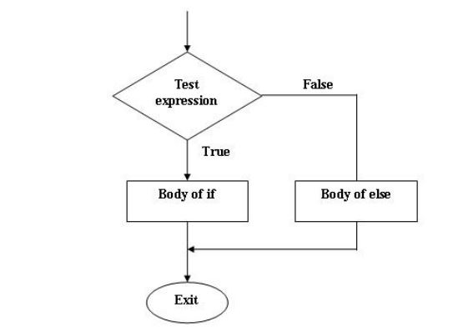
Structure Of If Else Statement

Slide 11
Switch Statement
Also called case statement.
A multi-way decision making statement.
Specific block for each condition.
When one condition satisfied, respective block is executed.
If no conditions are true, default code will be executed.

Slide 12
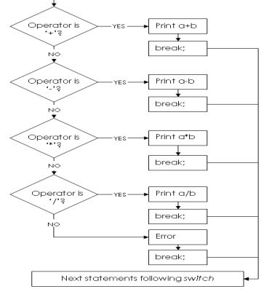
Example For Switch Case Statement

Slide 13
Drawing Flowchart Using MS Visio
Open the application.
Select New Folder option.
Set the algorithm.
Sequence the order.
Select the required shape from sidebar.
Drag and drop shapes and assign names.
Connect the shapes using connectors.
Review.
Download in any format.

Slide 14
Applications
Planning a new project and assign tasks.
Step by step auditing of process.
Managing the workflows.
Integrating with other algorithms.
Data management.
Mapping computer algorithms.
Used in process engineering industries.

Slide 15
Final Words
Flowcharts designed before project commencing.
Helps in identifying malfunctions.
Useful for non-technical professionals.
Newer sophisticated flowcharts evolving.
Software automate flowcharting.
Software read source code and construct flowcharts.

